Slide 1
THE RELEVANCE OF INTERNATIONAL COOPERATIVE PRINCIPLES RELATED TO THE EU LAW
Dr. Klára Bak
Expert
Cooperative Research Institute (Hungary)

Slide 2
THE STARTING POINTS OF THE ISSUE
I. The cooperative form is in the spotlight both at international and EU level in the 21th century
II. The cooperative is the only enterprise having operation principles determined by an international organization (International Cooperative Alliance)
III. The question of the correct interpretation, application and enforcement of all the international cooperative principles has emerged
at some member-state-levels related to the national cooperative law - e.g. Hungary, Poland
at the level of the EU related to the Council Regulation (EC) No 1435/2003 of 22 July 2003 on the Statute for a European Cooperative Society (SCE)

Slide 3
RECOMMENDATION 193 CONCERNING PROMOTION OF COOPERATIVES
International Labour Organization
(2002)
„The General Conference of the International Labour Organization,…Recognizing the importance of cooperatives in job creation, mobilizing resources, generating investment and their contribution to the economy, and
Recognizing that cooperatives in their various forms promote the fullest participation in the economic and social development of all people, adopts this twentieth day of June of the year two thousand and two the following Recommendation, which may be cited as the Promotion of Cooperatives Recommendation, 2002.”

Slide 4
COMMUNICATION FROM THE COMMISSION TO THE COUNCIL AND THE EUROPEAN PARLIAMENT, THE EUROPEAN ECONOMIC AND SOCIAL COMMITTEE AND THE COMMITTEE OF REGIONS ON THE PROMOTION OF CO-OPERATIVE SOCIETIES IN EUROPE /COM/2004/0018FINAL/
„The cooperative is a means for providing high quality services.”
„The cooperatives may be a means for building or increasing economic power of Small and Medium-sized Enterprises (SMEs) in the market.”
„…co-operatives continue to make an important contribution to economic dynamism and growth”
„The cooperatives help to the building a knowledge-based society.”

Slide 5
EUROPEAN PARLIAMENT RESOLUTION OF 2 JULY 2013 ON THE CONTRIBUTION OF COOPERATIVES TO OVERCOMING THE CRISIS (2012/2321(INI))
„…cooperatives…play an essential role in the European economy…”
„cooperatives play a very important role in the EU in economic, social, sustainable development, and employment terms…and help to serve the objective of the sustainable economic and social development of regional and local communities;”

Slide 6
COOPERATIVES
Cooperatives are able to handle the challenges of the 21th century, especially
fundamentally contribute to the competitiveness of economies;
Crucially promote social coherence;
are one of the basic institutions of social economy;
are excellent means of the employment policy;
play an outstanding role in rural development, nature protection and agro-environmental protection;
have an outstanding cultural role;
are important in the education
The economic, social, environmental and cultural sustainability cannot be realised without cooperatives.

Slide 7
Source: The power of cooperation, Cooperatives Europe key figures, 2015, https://coopseurope.coop/

Slide 8
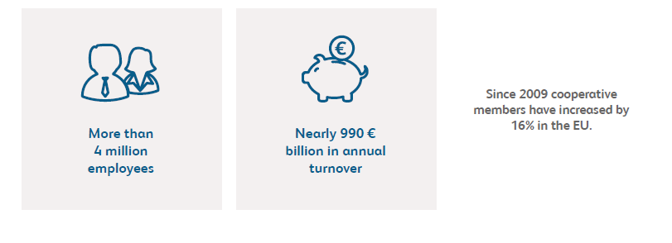
Source: The power of cooperation, Cooperatives Europe key figures, 2015, https://coopseurope.coop/

Slide 9
WHAT IS A COOPERATIVE?
it is an enterprise form with an old and succesful tradition
it is an enterprise form with unique features, which are different from those of other enterprises
the members are owners, users, leaders and controllers at the same time
it is a business model and also a community

Slide 10
THE UNIQUE FEATURES OF COOPERATIVES
having complex goals:
to satisfy the economic needs of the cooperative members;
to satisfy social and cultural needs of the cooperative members
PURPOSE: improving quality of life for the members
having special functional principles;

Slide 11
STATEMENT ON THE CO-OPERATIVE IDENTITY
(International Cooperative Alliance)
(1995)
„A co-operative is an autonomous association of persons united voluntarily to meet their common economic,
social, and cultural needs and aspirations through a jointly-owned and democratically-controlled enterprise.”

Slide 12
STATEMENT ON THE CO-OPERATIVE IDENTITY
Co-operative values
self-help,
self-responsibility,
democracy,
equality,
solidarity,
honesty,
openness,
social responsibility,
caring for others.

Slide 13
STATEMENT ON THE CO-OPERATIVE IDENTITY
Co-operative Principles
Voluntary and Open Membership
Democratic Member Control
Member Economic Participation
Autonomy and Independence
Education, Training and Information
Cooperation among Co-operatives
Concern for Community

Slide 14
COOPERATIVE LAW IN HUNGARY
Main Sources of Cooperative Law:
Act V of 2013 on the Civil Code
Book Three „Legal Persons”
2. Act X of 2006 on Cooperatives
Act CXV of 2004 on Housing Cooperatives

Slide 15
COOPERATIVE LAW IN GERMANY
Cooperative Societies Act
(Genossenschaftsgesetz – GenG /1889/)
Special law- applicable to all types of cooperatives

Slide 16
DEFINITON OF COOPERATIVE
in the German Act on Cooperative
The nature of Cooperative Societies
Subsection 1:
Societies with a variable number of members, which have as their object to promote the income or economy of their members or their social or cultural needs/aspirations by means of a jointly owned and operated enterprise (cooperative societies), acquire the legal status of a registered cooperative society according to this Act.
- GOAL: to further and to support the activities of the members

Slide 17
Council Regulation (EC) No 1435/2003 of 22 July 2003 on the Statute for a European Cooperative Society (SCE)
It needs a revision
GOAL: reinforce its real economic essence and legal nature, as well as its social role.

Slide 18
RECOMMENDATIONS
to the Implementation of the
„Improvement of Cooperatives’ Legislation for Promotion of Social Coherence”
Project supported by Visegrád Fund

Slide 19
Recommendation 1: The participants of the conference recommend the governments and the competent institutions of the European Union to declare currently their expressed and obvious acknowledgement and support concerning the cooperative form.

Slide 20
Recommendation 2: The participants of the conference recommend the governments and the competent institutions of the European Union to make the required measures which the unique feature of cooperative form is acknowledged by - regarding its different operative principles from those of other companies. These special principles may realise the complex advantages hidden in cooperatives.

Slide 21
Recommendation 3: Furthermore the participants of the conference recommend the competent institutions of the European Union to revise the valid cooperative law of the European Union and they also recommend each government to revise the valid cooperative law of the member states - the revision is supposed to be based on the international cooperative principles and values defined by the International Cooperative Alliance.

Slide 22
Recommendation 4: The participants of the conference recommend the competent institutions of the European Union to declare the expressed acknowledgement of the international cooperative principles and values by implying them completely and with obligatory legal nature to the text of the Council Regulation on the Statute for a European Cooperative Society (SCE), in the frame of the revision of the valid cooperative law of the European Union, more precisely in the frame of the revision of the Council Regulation on European Cooperative Society.

Slide 23
Recommendation 5: The participants of the conference recommend the competent institutions of the European Union to create a directive in which all the international cooperative principles are treated as an obligatory part of the cooperative law of the community and the member states – since a directive with such content would obviously support the valid cooperative regulation of the member states.

